Slide 1
ModEDI
An Extendable Software Architecture for Examining the Effects of Developmental Interactions on Evolutionary Trajectories
Elizabeth Brooks
Dept. of Computer Science
Western Washington University
Graham Roberts
Dept. of Computer Science
Western Washington University
Alison Scoville
Dept. of Biology
Central Washington University
Filip Jagodzinski
Dept. of Computer Science
Western Washington University
Notes:
Hello I am Elizabeth Brooks…. Today we are presenting ModEDI….. This software architecture may be used to test evolutionary-developmental and quantitative genetic hypotheses.

Slide 2
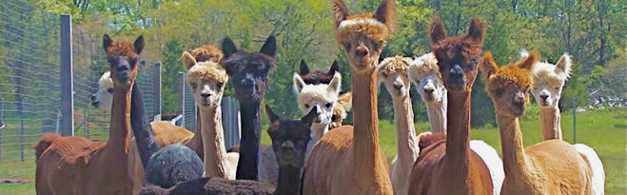
Background - Quantitative Genetics
http://www.bio.miami.edu/dana/250/250SS15_2print.html
Notes:
Quantitative genetics is the study of complex biological traits, or traits controlled by more than one gene. A primary goal of quantitative genetics studies is the development of computational models for predicting the evolution of such traits in response to selection.

Slide 3
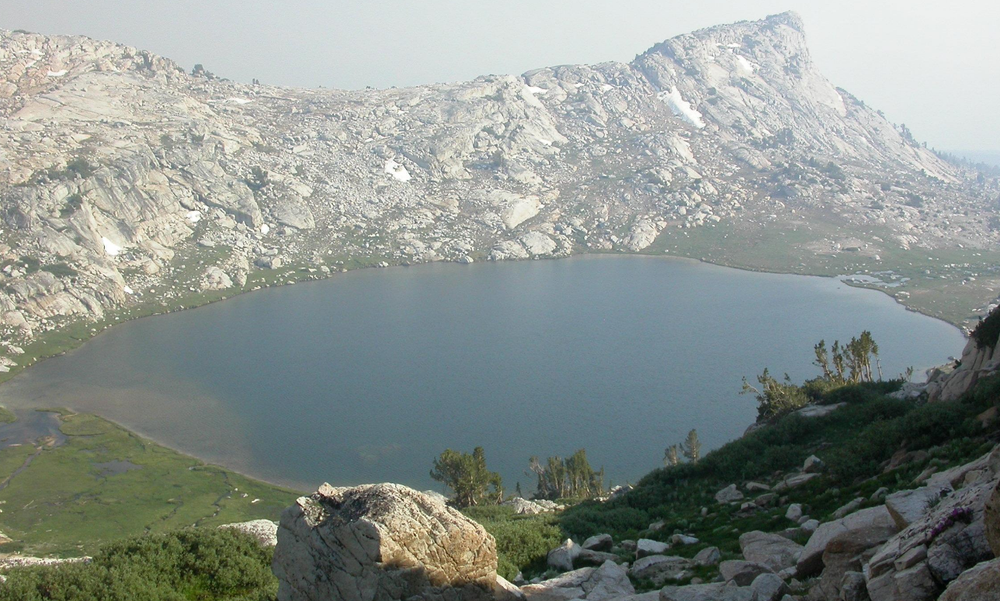
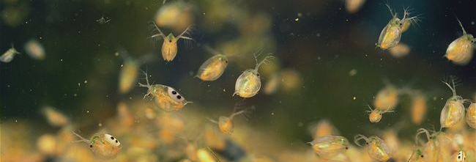
Models for Daphnia
http://andynewman.org/html/daphnia_water_flea.html
http://www.archive.org
Notes:
To investigate these complex genetic dynamics, we have developed models of quantitative trait evolution for Daphnia melanica. Daphnia are a freshwater microcrustacean, commonly found in high alpine lakes of the Sierra Nevada.

Slide 4
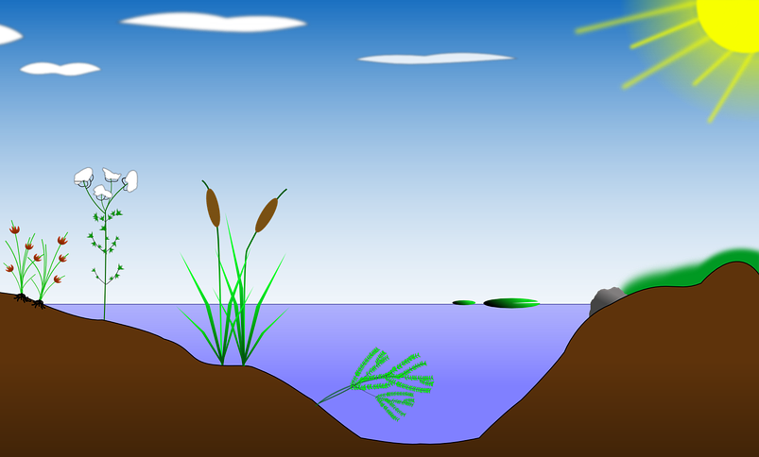
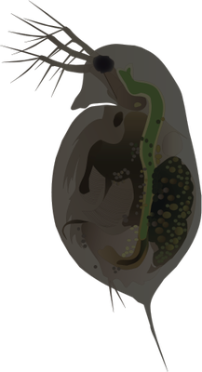


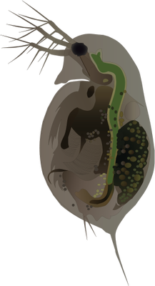

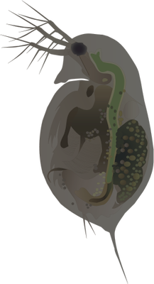

Nonlinear Developmental Interactions (NDI)
http://ian.umces.edu/imagelibrary/displayimage-4387.html
https://pixabay.com/en/biotope-lake-pond-habitat-reed-154853/
Notes:
In these lakes, Daphnia will swim near the water’s surface, receiving a high amount of UV radiation and be dark in pigmentation.

Slide 5
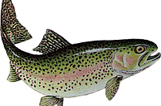
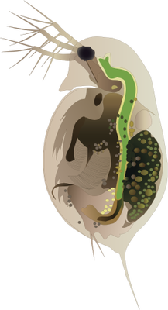
Nonlinear Developmental Interactions (NDI)
http://www.smoka.co.uk/trout
Notes:
When fish predators are introduced into one of these lakes, usually for sport fishing, the Daphnia will migrate lower in the water column to avoid them. By being lower in the water column, the Daphnia receive less UV radiation and are lighter in pigmentation.

Slide 6
Central Concept - Fitness Surface
https://commons.wikimedia.org/wiki/File:Visualization_of_a_population_evolving_in_a_static_fitness_landscape.gif
Notes:
Quantitative genetic models recognize that two elements are needed to predict the evolution of traits due to selection: the strength and direction of selection, and the availability of heritable genetic variation. The strength and direction of selection is captured by the individual fitness surface, which describes the expected reproductive success of an individual as a function of its trait values.

Slide 7
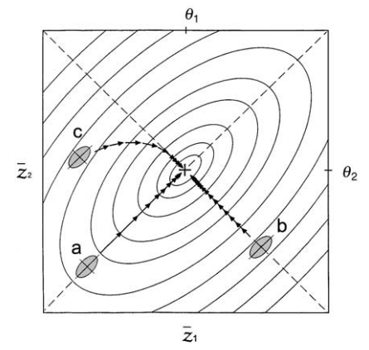
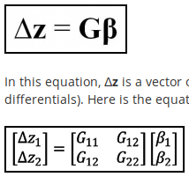
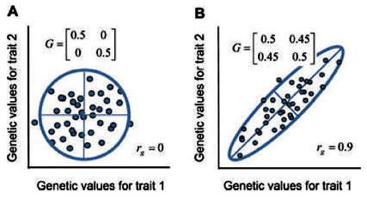
Central Concept - GMatrix
Notes:
“Although the population tends to evolve uphill under frequency-independent selection, the mean generally does not evolve in the direction of greatest improvement in average fitness, the direction of which is given by the directional selection gradients. Instead the population will take a curved path that deviates from this direction of greatest improvement (Lande, 1979, 1980a). Such curved paths arise
from unequal genetic variances (i.e., some characters having greater genetic variance than others) and from genetic covariance. These genetic parameters affect both the rate and direction of evolution and are represented by a variance–covariance matrix known as the
G-matrix.”
“The additive genetic variances for trait one and trait two are given by G11 and G22, and G12 is the additive genetic covariance. The covariance is similar to the correlation, except correlations are standardized to take values between -1 and +1 while covariances are not. Thus, the G-matrix tells us how much genetic variation each trait has, as well as the extent to which the traits are genetically correlated with one another. The importance of the G-matrix can be seen by its role in the multivariate breeder’s equation.”
“In this equation, Δz is a vector of changes in mean trait values, and β is a vector of selection gradients for the traits (similar to selection differentials). Here is the equation with the G-matrix and vectors written out for the two trait case.”
“In the above graph, the traits are uncorrelated. The values of G11 and G22 would be positive, but G12 would be zero. When G12 is zero, the multivariate breeder’s equation reduces to the univariate version, and the traits evolve independently from one another. However, traits often are genetically correlated, as shown on the next graph.”
“In the graph above, trait one exhibits a positive genetic correlation with trait two, so these traits would not evolve independently. If selection acted on trait one, trait two also would change in value even without any direct selection on trait two. For example, if large values of trait one were favored by natural selection, then trait two would increase as well over time because individuals with large values of trait one happen to have large values of trait two. This would produce a correlated response to selection. This genetic correlation can be graphically depicted in an intuitively pleasing way by drawing an ellipse around 95 percent of the breeding values in the population.”

Slide 8
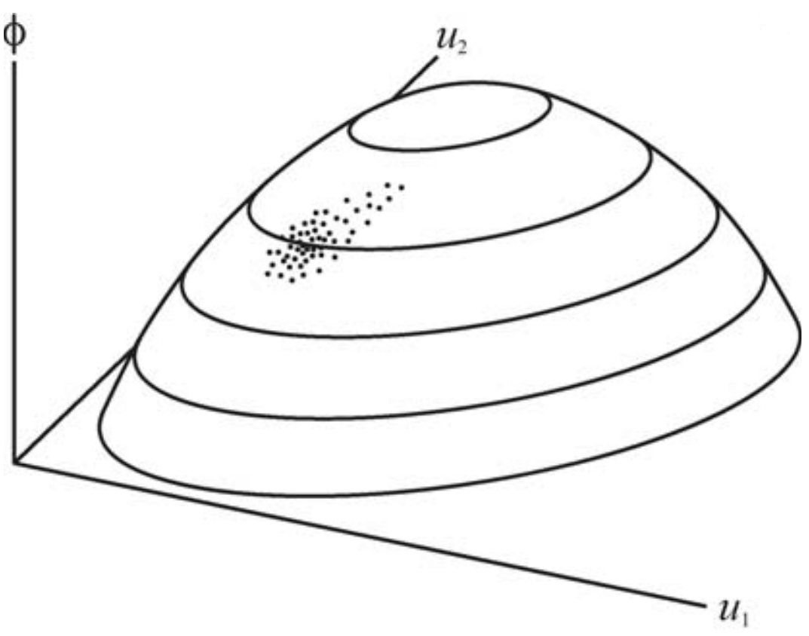
Central Concept - Phenotype Surface
ϕ represents a physical trait
u₁ and u₂ represent underlying genetic factors
Measures genetic variances
Additive
Dominance
Epistasis
Environmental
http://www.faculty.biol.ttu.edu/rice/rice08b.pdf
Notes:
The phenotype surface is constructed by plotting the value of a phenotype against the values of underlying genetic and environmental factors that interact in its development. (a) A nonlinear phenotype landscape representing a trait as a function of two underlying genetic factors. The cloud of points on the surface represents a population, each point corresponding to an individual.

Slide 9
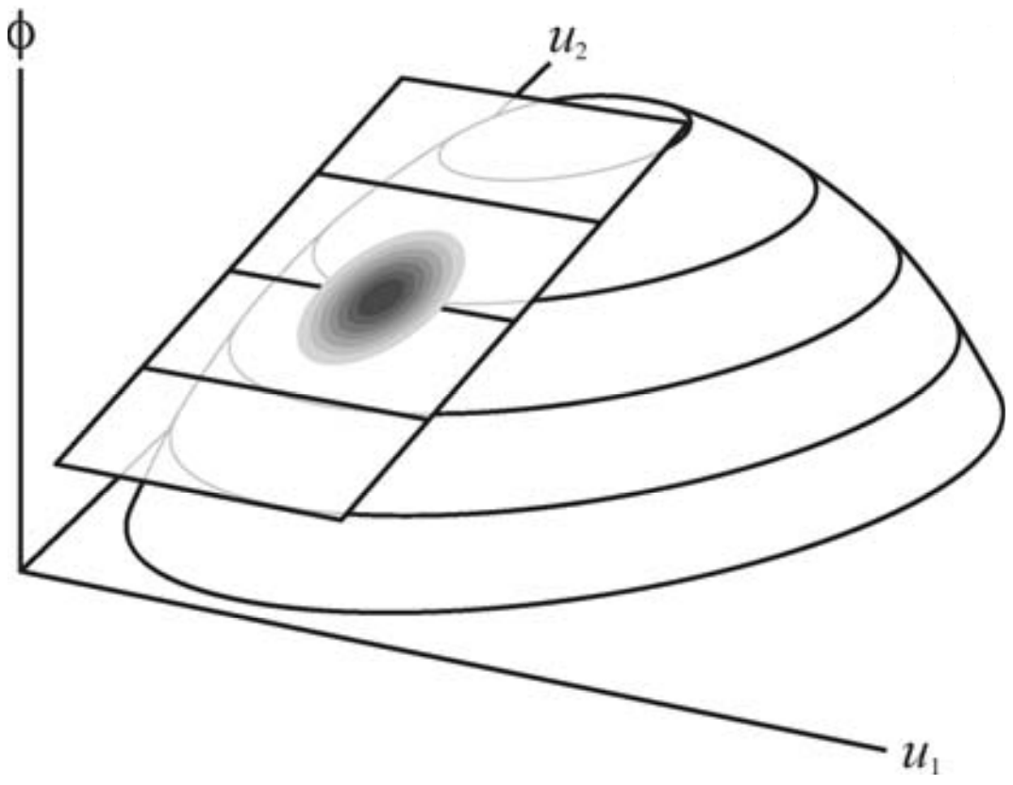
Phenotype Surface vs GMatrix
Phenotype Surface
G-matrix Approximation
Notes:
(b) G-matrix models consider a tangent plane and treat the population as a multivariate normal distribution.

Slide 10
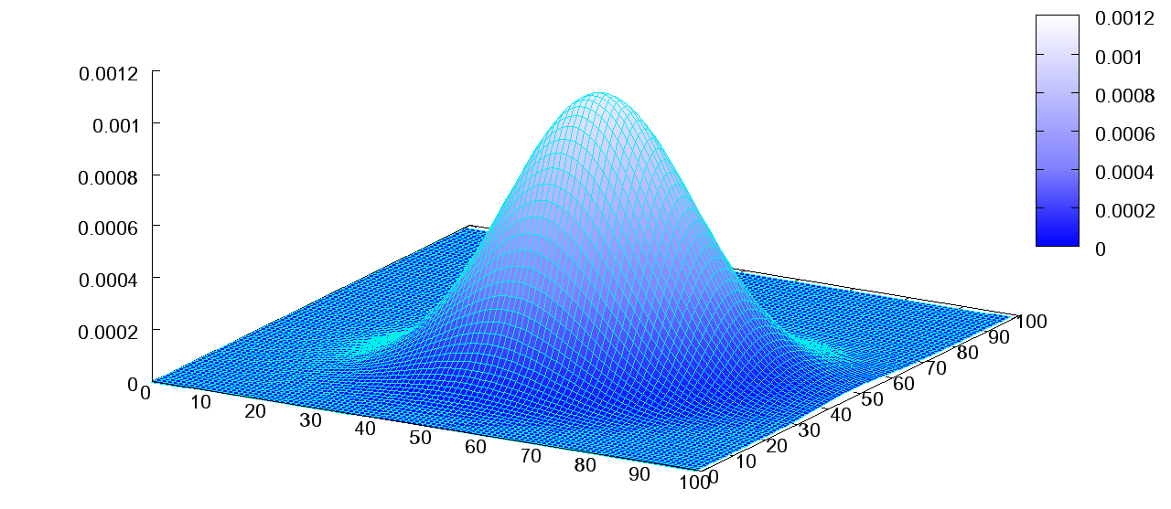
Surface Distribution - Bivariate Normal
x and y are normally distributed values
The sum of x and y form the bivariate normal distribution
x + y
y
x
w = N(<x>,σₓ) + N(<y>,σᵧ)
https://commons.wikimedia.org/wiki/File:Multivariate_Gaussian.png

Slide 11
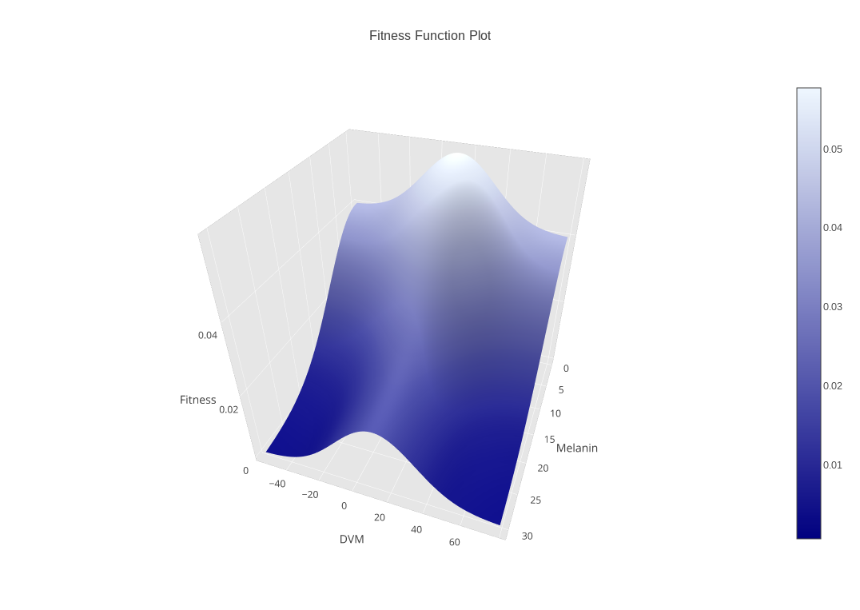
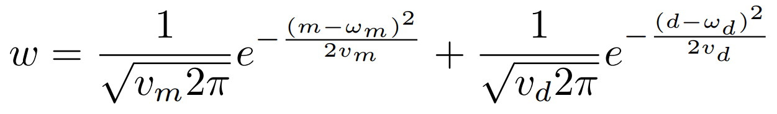
Surface Distribution - Bivariate Normal
Melanin and DVM are normally distributed trait values
The sum of Melanin and DVM form the bivariate normal distribution

Slide 12
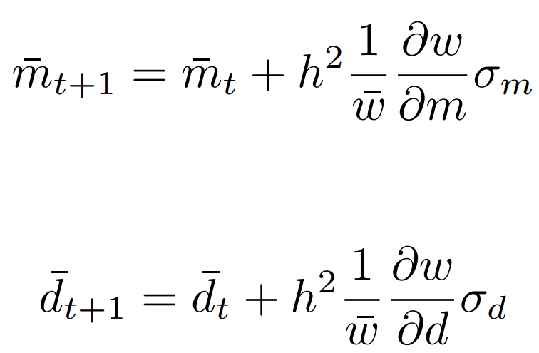
Classic Model - G-matrix
h² is the diagonal values of the heritability matrix
w is the mean population fitness
σ_{d} and σ_{m} are the DVM (d) and Melanin (m) phenotypic variances
Melanin development:
DVM development:
Notes:
The G-Matrix model for Daphnia describes the development of physical traits independently, related only through the fitness surface. A key insight, that developmental processes structure the geometry of the G-matrix, promises to transform our understanding of evolutionary patterns.
In the above graph, the traits are uncorrelated. The values of G11 and G22 would be positive, but G12 would be zero. When G12 is zero, the multivariate breeder’s equation reduces to the univariate version, and the traits evolve independently from one another. However, traits often are genetically correlated, as shown on the next graph.

Slide 13
Tanning Model - Phenotype Surface
ϕ represents a physical trait, Melanin
u₁ and u₂ represent underlying genetic factors, Average Daytime Depth and Sensitivity to UVB
Sensitivity to UVB
Melanin
Average Daytime Depth

Slide 14
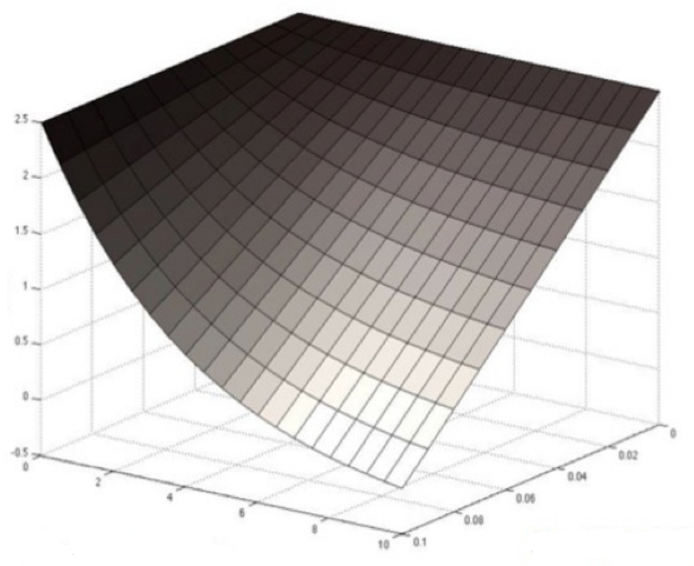
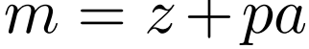
Tanning Model - Phenotype Surface
z is the concentration of melanin produced in response to UV light
p is the slope of the reaction norm indicating sensitivity to UVB
a is the change in UVB exposure
Melanin
Sensitivity to UVB
Average Daytime Depth
Notes:
Here is an example of the phenotype surface for Daphnia, as described by this linear function for the production of melanin with respect to these underlying genetic factors.

Slide 15
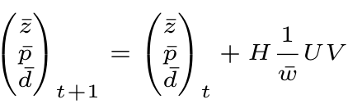
Tanning Model - NDI
d is DVM, treated as a quantitative genetic trait
H is the heritability matrix
U represents the change in DVM, simplified
V represents the change in Melanin, simplified
Melanin production:
Development of genetic factors:

Slide 16
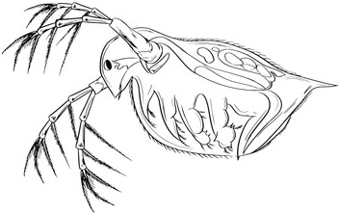
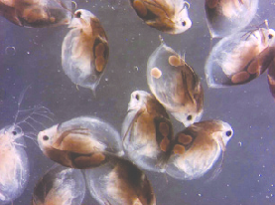
Daphnia Species Objects
Daphnia Blueprint
States represent phenotypic traits, DVM and Melanin
Behaviours represent the phenotypic functions of the Classic and Tanning Daphnia models
Daphnia Objects
Daphnia melanica
- DVM: int - Melanin: int
+ setDVM + setMelanin
https://t3.ftcdn.net/jpg/00/47/53/14/240_F_47531414_8Vj6iYmdowUNtgFrxmmtgPdT8gRTzCdy.jpg
https://www.researchgate.net/figure/51073279_fig5_Fig-5-Pigmented-zooplankton-Melanised-Daphnia-umbra-left-and-Eudiaptomus-graciloides
Notes:
The object-oriented software architecture of ModEDI describes the evolution of physical traits of Daphnia by describing a blueprint for objects of individual daphnia, where the states represent the phenotypic traits Melanin and DVM, and the behaviours of the Daphnia object describe the development of these states.

Slide 17
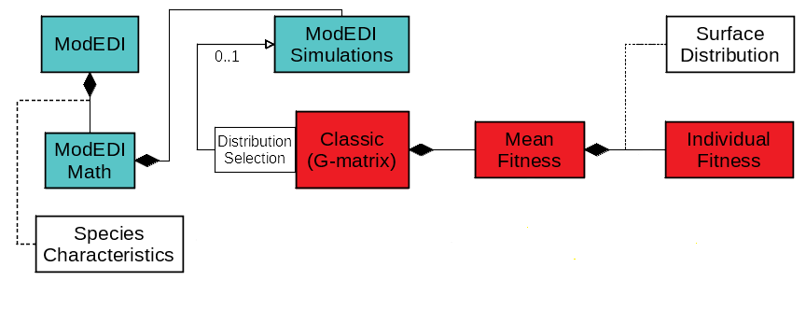
Software Architecture - Classic Model
Notes:
Evolutionary trajectories of physical traits are projected by the Classic model by first retrieving the input initial values stored in the Species Characteristics interface, and qualified by the probability distribution selected by the user. The fitness surface is described by the Mean Fitness class by simulating populations of individual Daphnia with the Individual Fitness class, following the distribution specified by the user and described by the Surface Distribution interface.

Slide 18
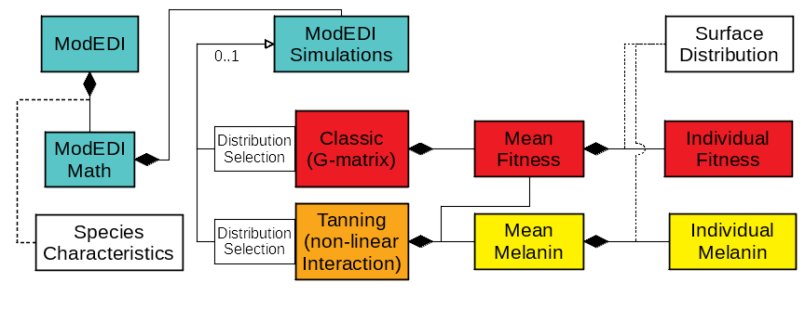
Software Architecture - Tanning Model
Notes:
The Tanning model, however, projects the evolution of physical traits by drawing from the phenotype surface calculated by the Mean Melanin class. The phenotype surface is described by the function for melanin production in the Individual Melanin class, with the user specified distribution described by the Surface Distribution interface.

Slide 19
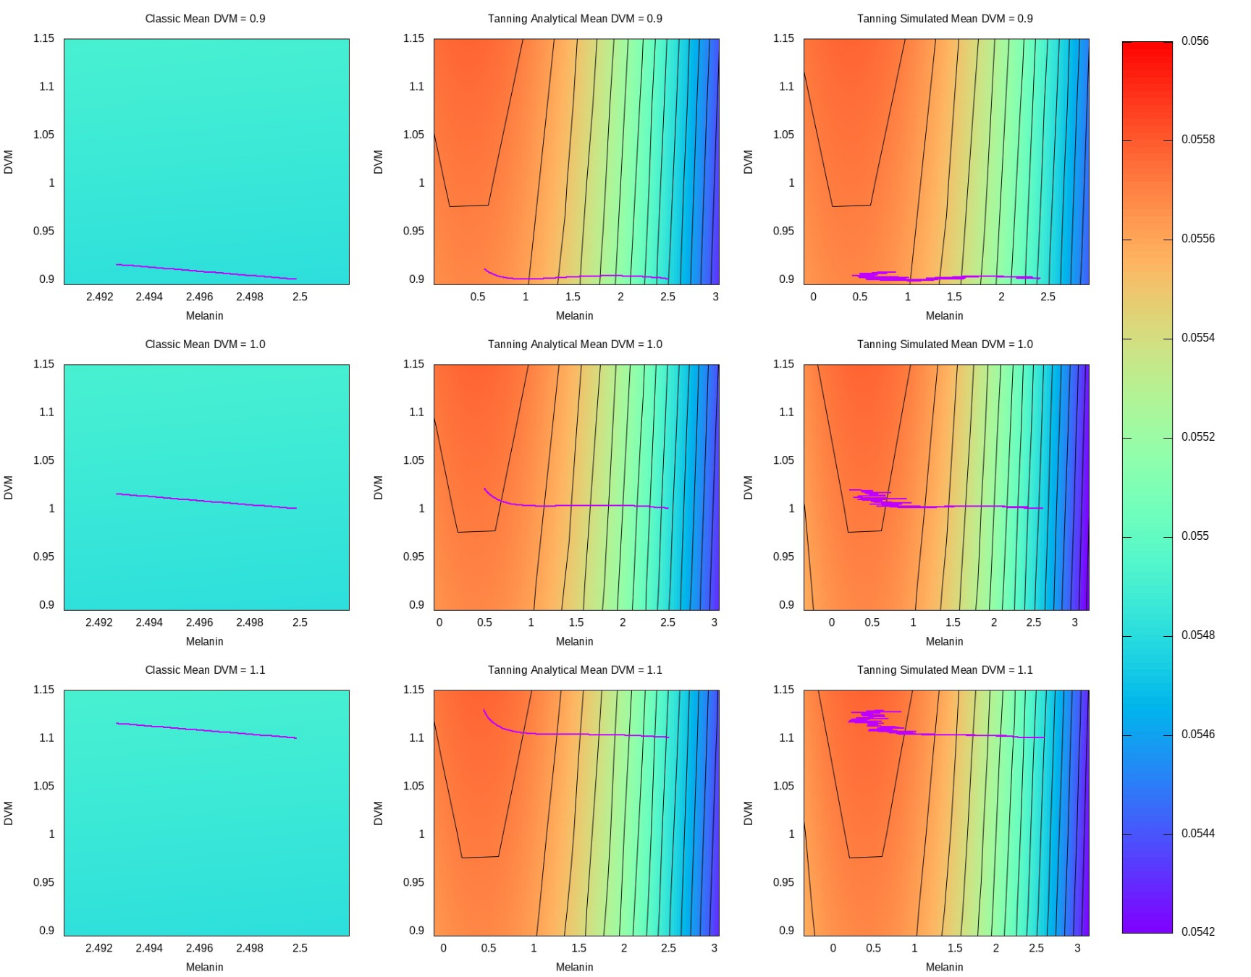
Mean DVM Parameter Sweep
Conclusions:
Less fluctuation in trajectories
Higher overall fitness
Quicker to reach trait optima
Classic model evolves more slowly than Tanning
Notes:
Values for UVB dose at the water surface and attenuation coefficient were obtained from Sequoia National Park in the Sierra Nevada Range. Values specific to Daphnia were obtained from empirical studies. Starting trait values match mean values from populations that have not been subject to fish predation. Fitness optima were estimated from mean trait values in populations that have been subject to selection by human-introduced fish predators for approximately 100 years. Variances of the fitness surface and heritability were chosen to represent plausible values.

Slide 20
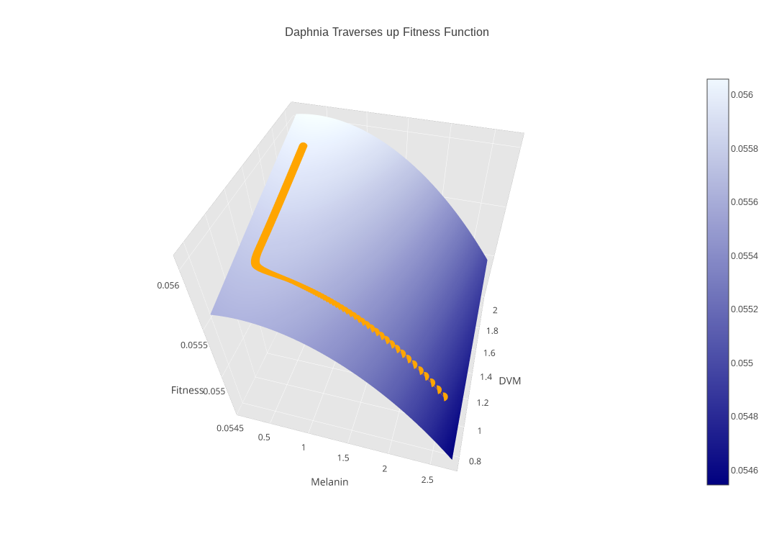
Daphnia Case Study - Results
Notes:
Values for UVB dose at the water surface and attenuation coefficient were obtained from Sequoia National Park in the Sierra Nevada Range. Values specific to Daphnia were obtained from empirical studies. Starting trait values match mean values from populations that have not been subject to fish predation. Fitness optima were estimated from mean trait values in populations that have been subject to selection by human-introduced fish predators for approximately 100 years. Variances of the fitness surface and heritability were chosen to represent plausible values.

Slide 21
Future Work
Increased generalization
Support any number of physical traits
Support any number of developmental factors for each trait
Add support for other fitness and phenotype distributions
Make available as a R package
Update online user interface

Slide 22
Acknowledgements
CWU Science Honors Research Program
WWU College of the Sciences and Engineering
Notes:
We would like to thank...

